Slide 1
Introduction to Olympic Villages
An Olympic Village is an accommodation centre built for an Olympic Games, usually
within an Olympic Park or elsewhere in a host city. Olympic Villages are built to house
all participating athletes, as well as officials, athletic trainers.
After the Munich Massacre at the 1972 Olympics, the Villages have been made
extremely secure. Only athletes, trainers and officials are allowed to room at the
Village, though family members and former Olympic athletes (typically to meet and
greet current athletes as part of a national delegation) are allowed inside with proper
credentials. Press and media are also barred.
The idea of the Olympic Village comes from Pierre de Coubertin. Up until the 1924
Summer Olympic Games, National Olympic Committees rented locations around the
host city to house participants, which was expensive. For the 1924 Summer Olympics,
the organizers built cabins near the Stade Olympique de Colombes to allow the
athletes to easily access the Games' venues. The Olympic Village of the 1932 Summer
Olympics served as the model of today's Olympic Villages; it consisted of a group of
buildings with rooms to lodge athletes, and buildings with other commodities.

Slide 2
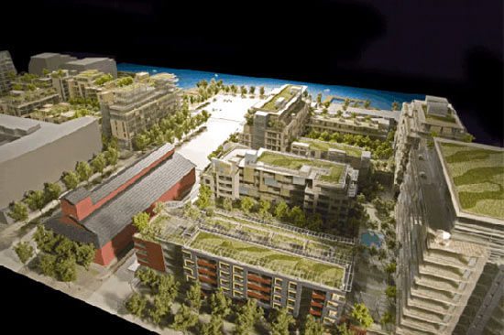
Introduction to Olympic Villages
Example of an Olympic Village

